Slide 1
Welcome to Lab!
Getting started with 1300

Slide 2
Starting Objectives
Is your computer set up?
Can you create a file/folder system?
Can you navigate your command line?
Is VS Code prepped?
Are you familiar with iLearn?
Do you understand the submission process?

Slide 3

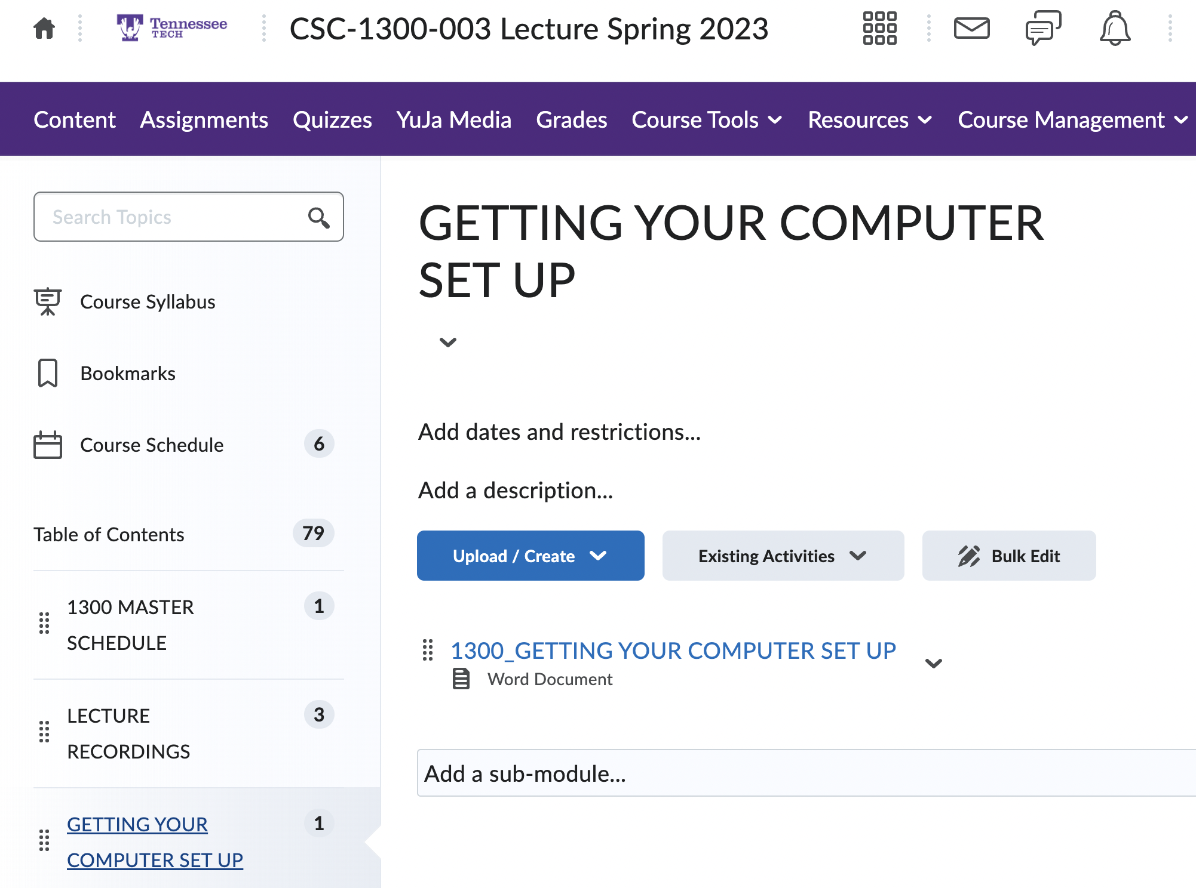

Setting up your computer
Check iLearn for a pdf on setting up your computer
Process differs based on whether you’re working on Mac, Windows, etc.

Slide 4
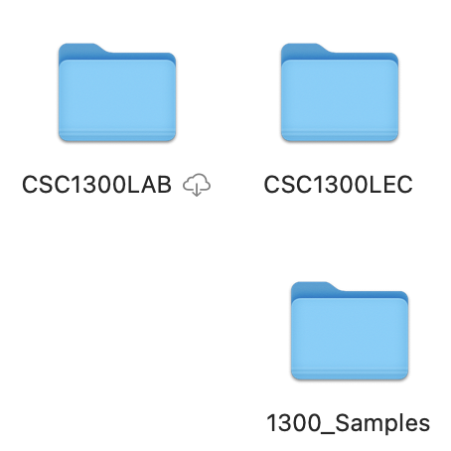
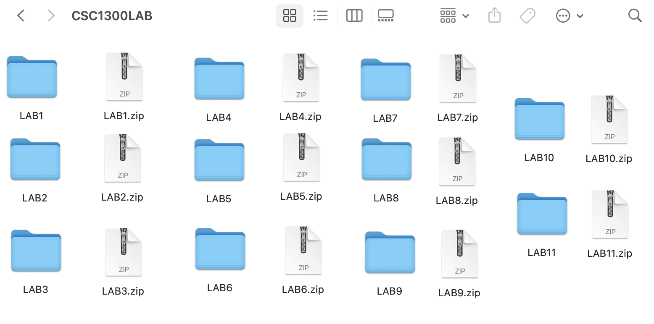
Files and Folders
Folders (containers)
Files (code)

Slide 5
Advice and Suggestions
Please zip your files and name them correctly!!!
Double check all submissions
Don’t forget documentation
Test your code throughout (for your sake & ours)
Asking for help is expected and for your benefit!

Slide 6
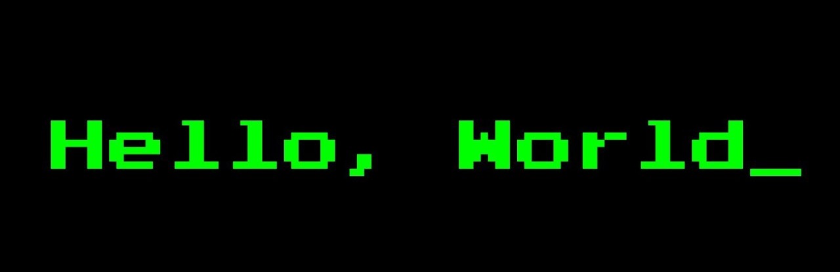
What is Coding?
Coding is a language, just like English and Spanish
Coding is how we communicate with computers
Coding is taking a set of instructions, and translating it for a computer
This Photo by Unknown Author is licensed under CC BY-SA

Slide 7
General Coding Method
What are you wanting your code to do?
How can you break it down to a process?
What coding devices or techniques relate?

Slide 8
Let’s try out an example!
(Don’t worry, we aren’t grading you on this example. We just want to make sure you know the basics)

